Slide 1
UML
The Unified Modeling Language (UML) is a graphical language for OOAD that gives a standard way to write a software system’s blueprint. It helps to visualize, specify, construct, and document the artifacts of an object-oriented system. It is used to depict the structures and the relationships in a complex system.
There are 2 basic kinds of UML Diagram, namely −
Structure Diagrams
Class Diagram
Component Diagram
Deployment Diagram
Object Diagram
Package Diagram
Behavioral Diagrams
Use Case Diagram
Activity Diagram
State Machine Diagram
Sequence Diagram
Timing Diagram

Slide 2

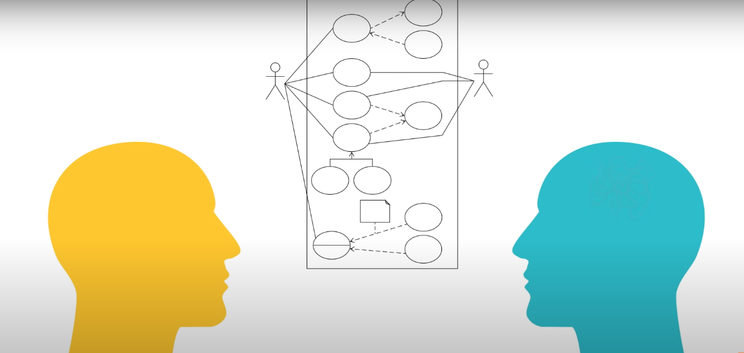
Use case diagram
To model a system, the most important aspect is to capture the dynamic behavior. Dynamic behavior means the behavior of the system when it is running/operating.
Use case diagrams are considered for high level requirement analysis of a system. When the requirements of a system are analyzed, the functionalities are captured in use cases

Slide 3
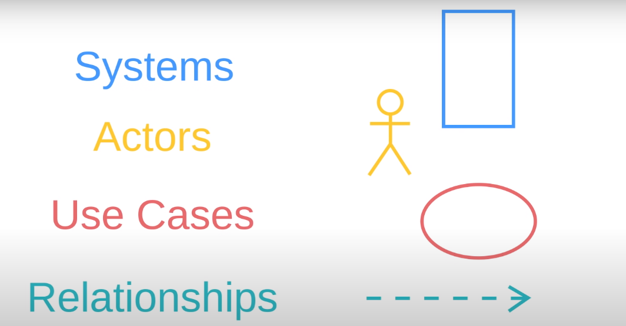
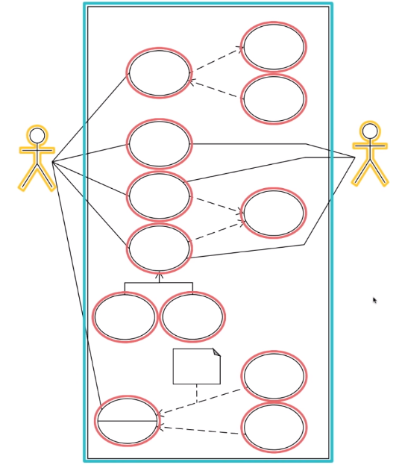
Use case Diagram
Components of Use case diagram.

Slide 4


Slide 5
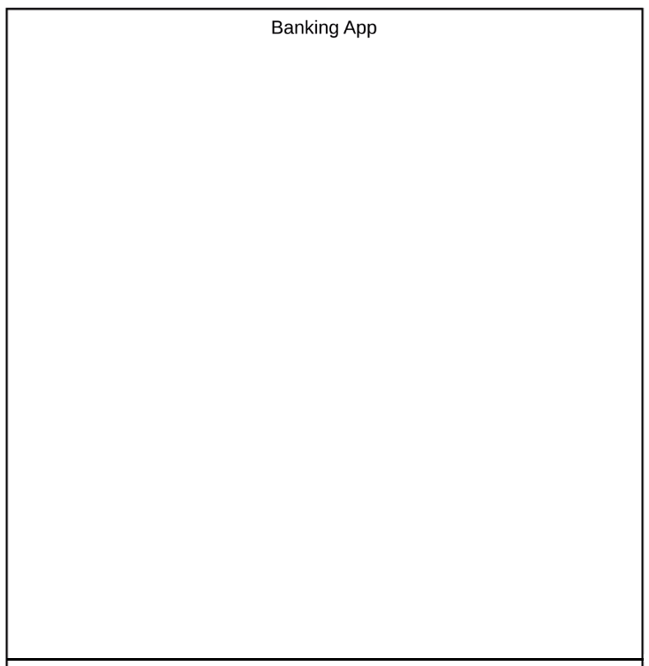
System is represented by a rectangle and name of system is put at the top
Anything within this rectangle happens within the Banking App.
Anything outside this rectangle doesn’t happen in the Banking
App.

Slide 6
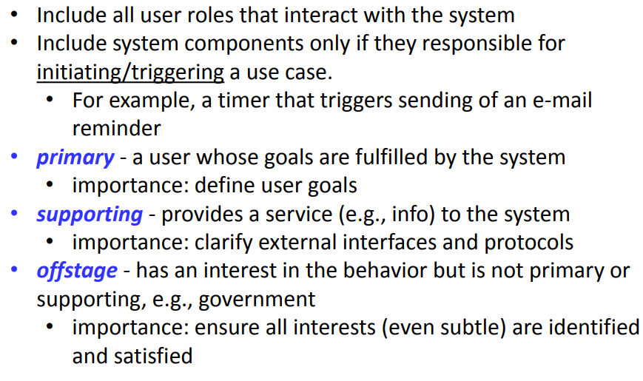
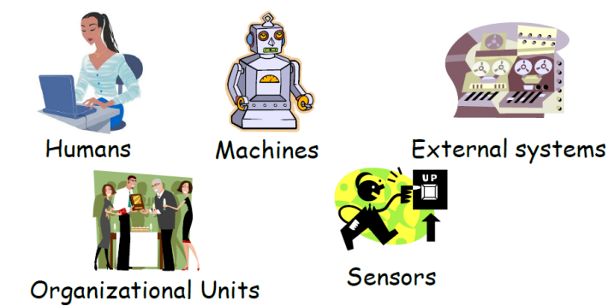
Actor

Slide 7
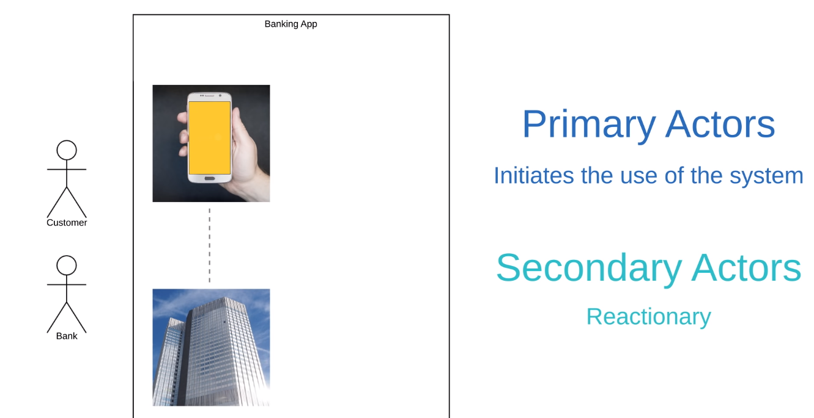
First, it’s important to note that these actors are external objects. They always need to be placed outside of our system.
Keep things categorical
Right now we’re saying that both Customers and Banks are going to use our app.

Slide 8
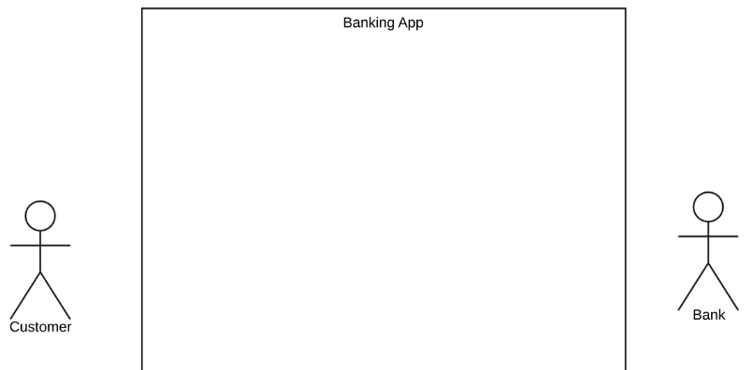
Primary actors should be to the left of the system, and secondary actors should be to on the right.
This just visually reinforces the fact that Customer engages with the Banking App and then the Bank reacts

Slide 9
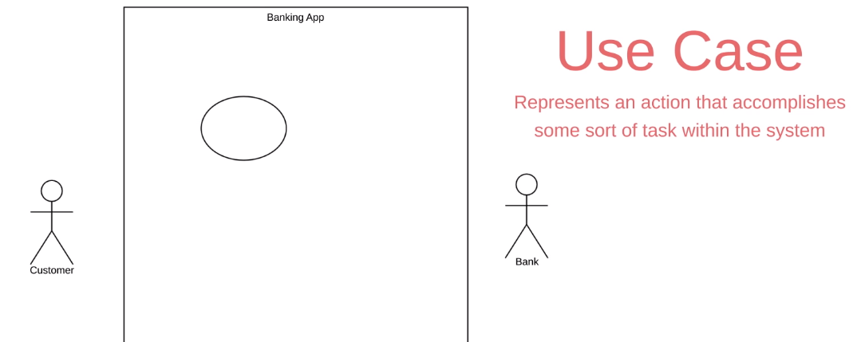
Use Case
The next element is a Use Case and this is where you really start to describe what your
system does.
A Use Case is depicted with this oval shape and it represents an action that accomplishes
some sort of task within the system
They’re going to be placed within the rectangle because they’re actions that occur within
the Banking App.

Slide 10
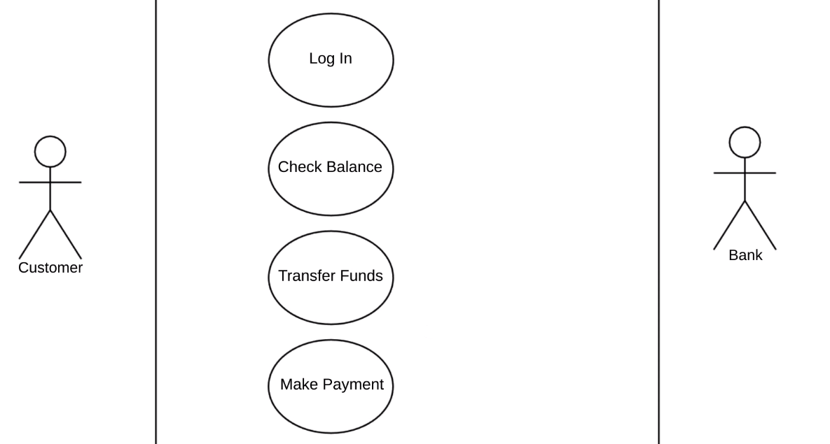
It’s good practice to put your Use Cases in a logical order when possible.

Slide 11
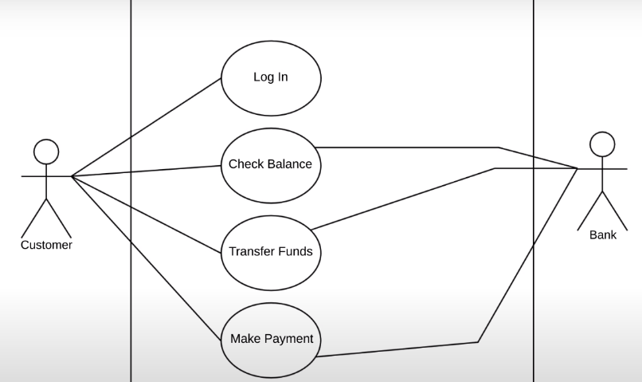
Relationship
In this example, a Customer is going to Log In to our Banking App.
So we draw a solid line between the Actor and the Use Case to show this relationship.
This type of relationship is called an association and it just signifies a basic communication or interaction

Slide 12
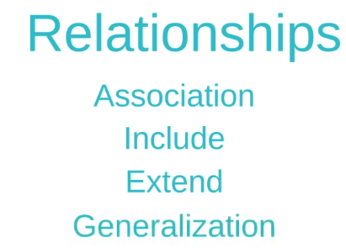

Slide 13
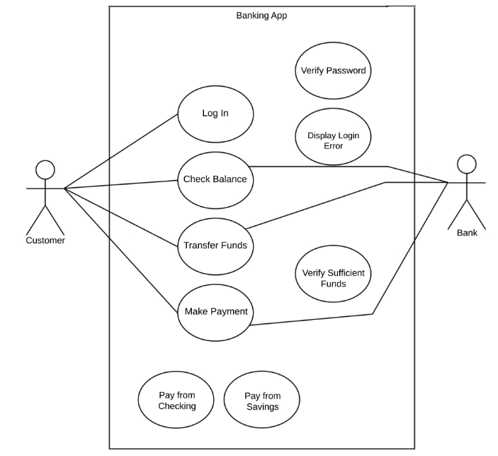

Slide 14
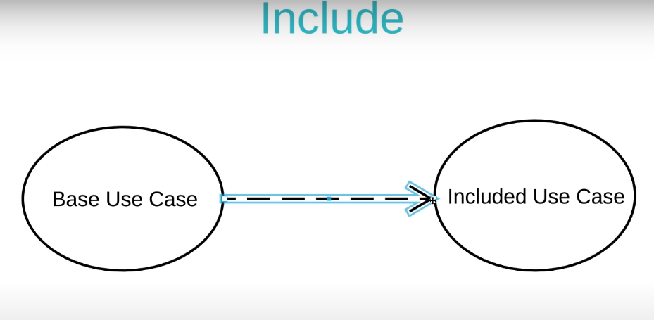
An Include relationship shows dependency between a base use case and an included use case.
Every time the base use case is executed, the included use case is executed as well.
Another way to think of it is that the base use case requires an included use case in
order to be complete.

Slide 15
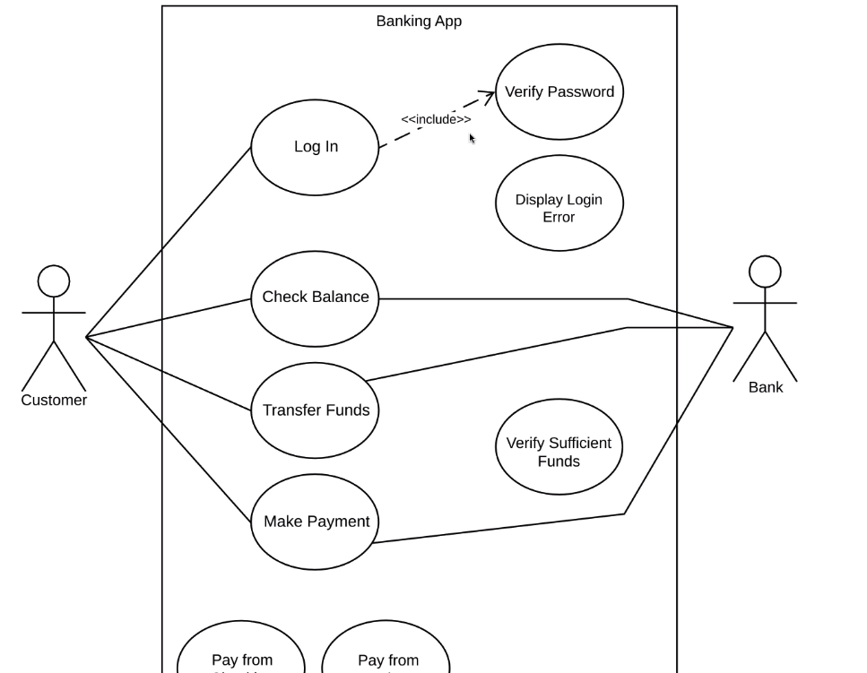

Slide 16
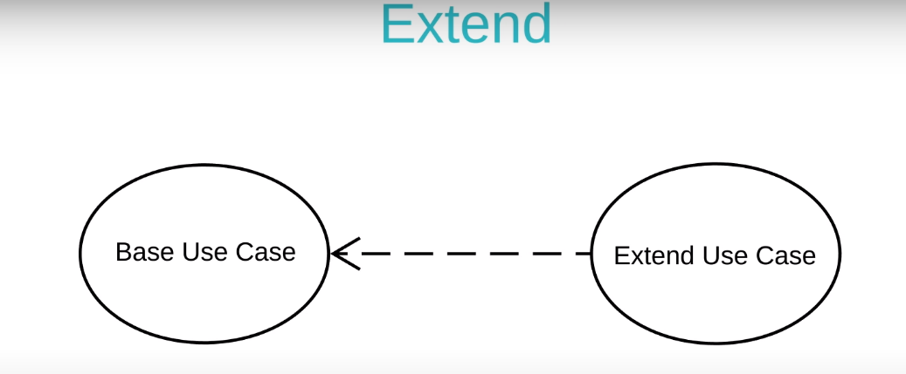
An extend relationship has a base use case and an extend use case.
When the base use case is executed, the extend use case will happen sometimes but not every time.
The extend use case will only happen if certain criteria are met.

Slide 17
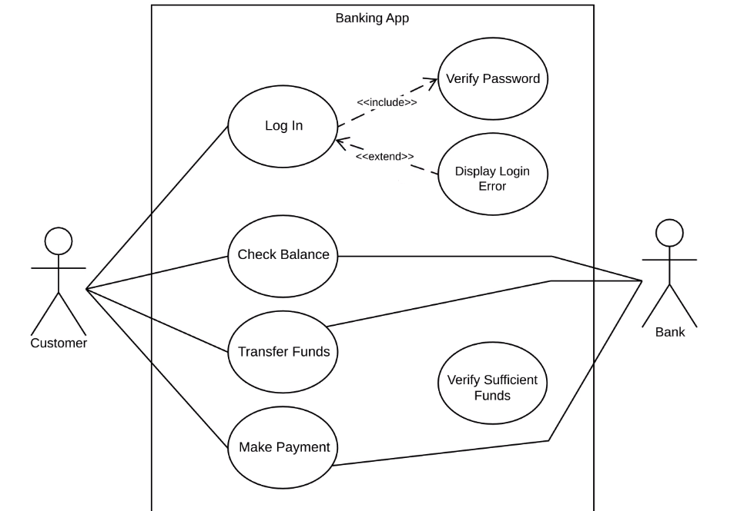

Slide 18
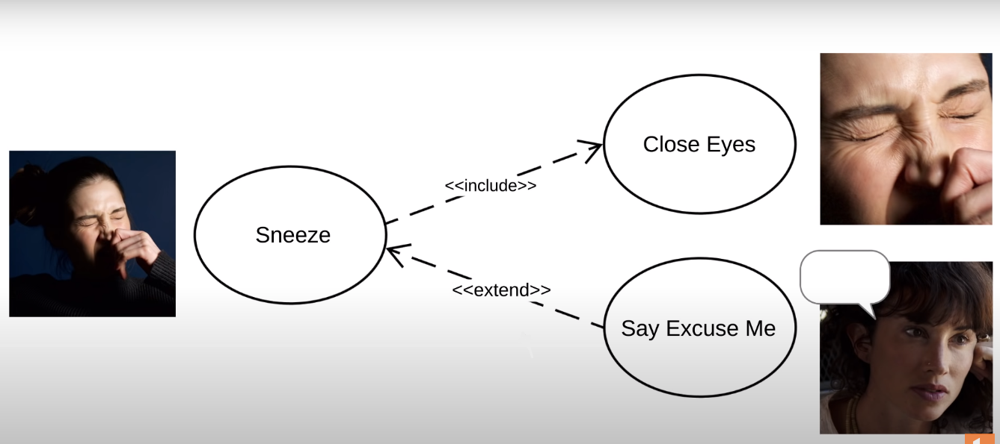
Just remember that include happens every time, extend happens just sometimes,

Slide 19
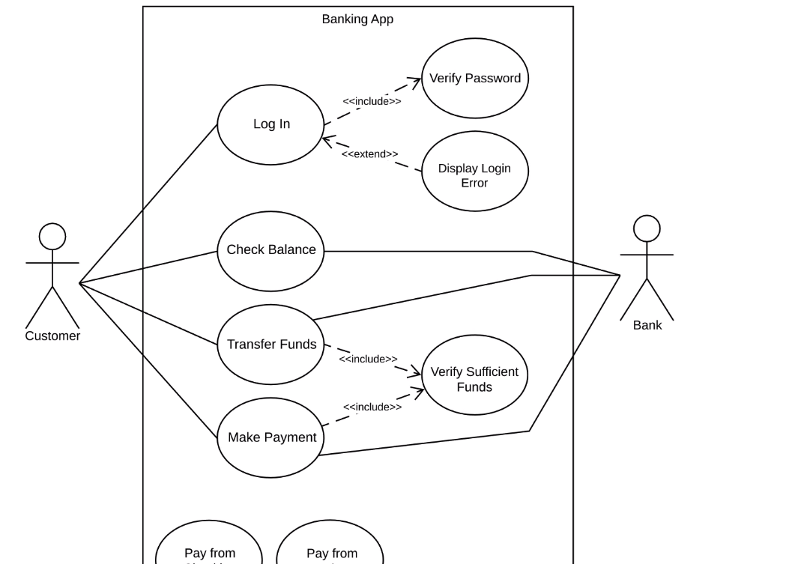

Slide 20
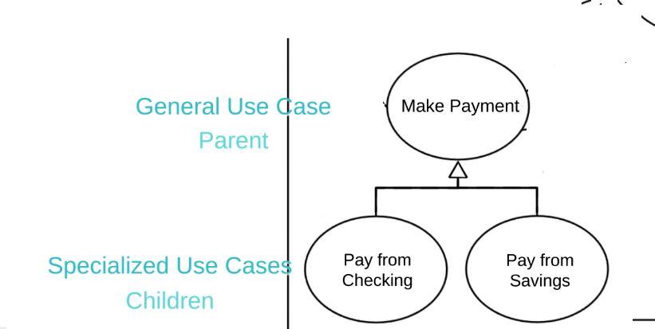
Generalization
One element (child) "is based on" another element (parent)

Slide 21
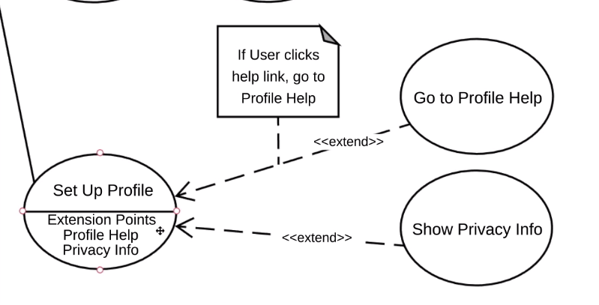
Extension Points
Extension points are just a detailed version of extend relationships.

